Slide 1
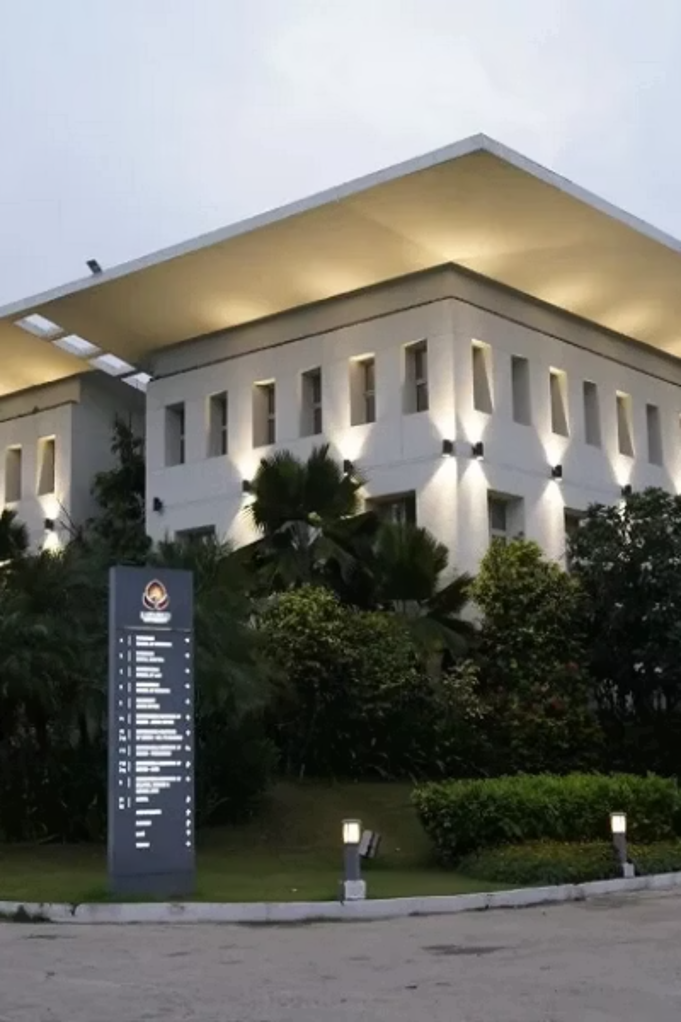
University Event Registration System
Cloud-Based Scalable Web Application
A modern, serverless event management platform built on Google Cloud Platform, designed to streamline student event registration across Tech Fests, Cultural Events, Workshops, and more. This project demonstrates the practical application of cloud-native architecture — including IaaS, PaaS, and SaaS principles — to solve real-world university challenges at scale.
Project Team
Platform
Neil Thakkar (KU2507U0028)
Parth Patel (KU2507U0023)
Google Cloud Platform (GCP) Serverless Architecture
Academic Year
2024–2025 Final Year Project Submission

Slide 2
The Problem: Scaling Student Event Management
Universities host dozens of events each semester — Tech Fests, Cultural Showcases, Professional Workshops, Guest Lectures, and Inter-departmental Competitions. As student populations grow and event formats evolve, the systems meant to manage participation are struggling to keep up.
Current Pain Points
What's Needed
Manual registration via spreadsheets or paper forms leads to errors, duplication, and long wait times
No real-time capacity tracking — events are frequently overbooked or under-attended
Fragmented communication — students miss events due to lack of timely notifications
Zero scalability — existing tools crash or slow down during high-demand periods like open registration windows
Data silos — no centralized record for attendance history, event analytics, or student preferences
A robust, cloud-native solution that addresses all these limitations with modern infrastructure. The ideal system must be:
Accessible
Available from any device, anywhere — browser-based with no installation required
Reliable
99.9%+ uptime with automatic failover and redundancy built into the infrastructure
Scalable
Capable of handling thousands of concurrent registrations without manual intervention

Slide 3
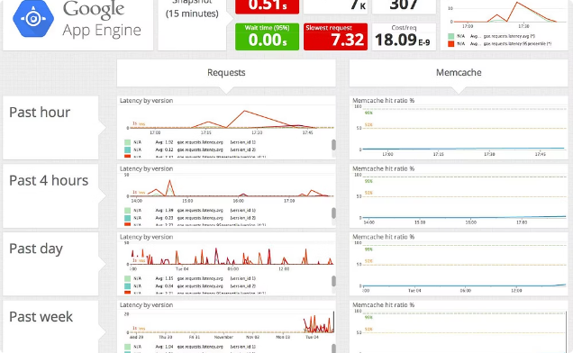
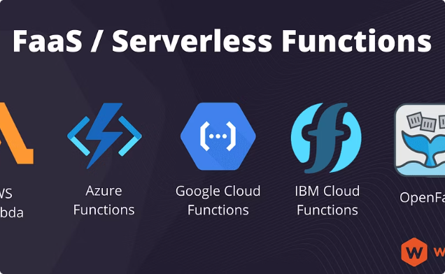
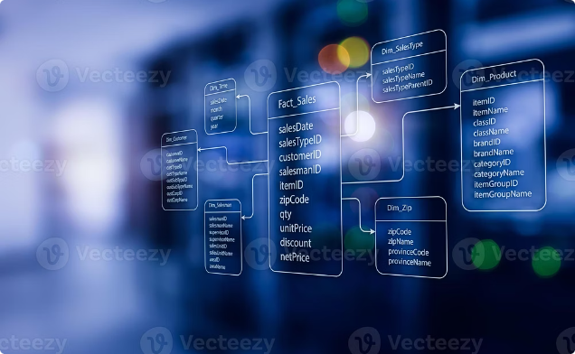

Cloud Solution Overview
The University Event Registration System is architected entirely on Google Cloud Platform, leveraging a serverless, fully managed stack. This eliminates manual server provisioning, reduces operational overhead, and enables teams to focus on delivering features rather than managing infrastructure. The system spans all three cloud service models.
Frontend — Google App Engine (PaaS)
Backend Logic — Cloud Functions (Serverless)
Database — Cloud SQL (Managed Relational DB)
The web application frontend is hosted on Google App Engine, a fully managed Platform-as-a-Service environment. App Engine handles HTTP routing, TLS termination, and auto-scaling automatically. Developers deploy code directly without configuring servers, OS patches, or load balancers. The frontend serves dynamic HTML/JS pages for the registration portal, event listings, and student dashboards.
Google Cloud Functions power all backend business logic — from processing registration requests and validating student credentials to sending confirmation responses. Each function is triggered on demand (HTTP or event-based), scales to zero when idle, and scales horizontally during traffic spikes. This event-driven model ensures cost-efficiency and zero idle compute cost.
Cloud SQL provides a fully managed PostgreSQL or MySQL database instance for persisting structured data — student profiles, event records, registrations, and capacity metadata. Google handles backups, patching, replication, and failover automatically. Cloud SQL supports ACID transactions, ensuring data integrity even during concurrent registration surges.
The system is entirely serverless — no virtual machines to provision, no OS to maintain. Google Cloud manages all underlying infrastructure, letting the development team focus on application logic and user experience.

Slide 4
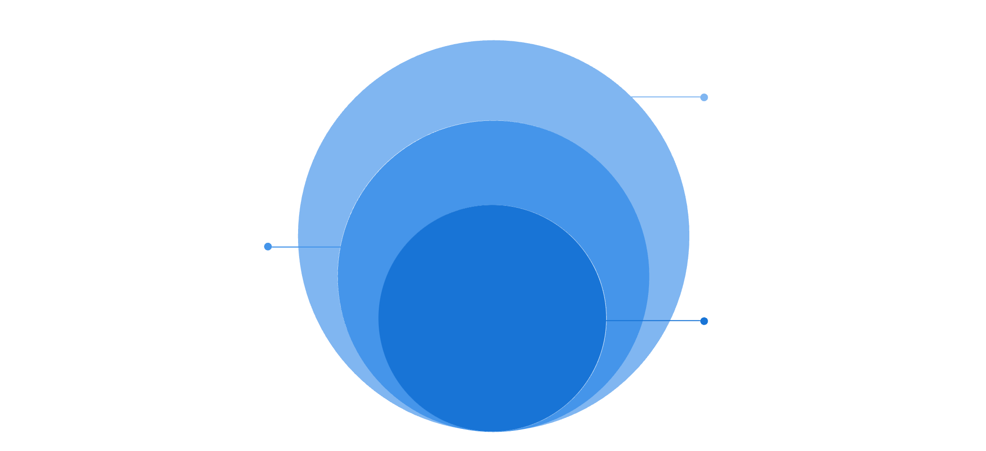
Architecture & Components
The system follows a loosely coupled, event-driven architecture — each component is independently deployable, scalable, and replaceable. Traffic flows through a DNS resolver and Cloud Load Balancer before reaching App Engine, ensuring high availability and geographic redundancy.
Application Layer
App Engine, Cloud Functions, load balancing
Data Layer
Cloud SQL structured storage
Core IAM
Security and access control
Each layer in this architecture has a clearly defined responsibility. The Load Balancer distributes incoming HTTP/S traffic across App Engine instances based on load. App Engine auto-scales the number of serving instances in real-time based on concurrent users — spinning up new instances within seconds during peak registration windows. Cloud Functions decouple backend logic from the frontend, enabling independent scaling of registration processing, notification dispatch, and data validation. Cloud SQL stores all relational data with enforced schemas and foreign key constraints. Finally, IAM (Identity and Access Management) governs which services and users can access which resources, applying the principle of least privilege across the entire stack.
DNS + Load Balancer
Cloud SQL
Routes users to the nearest healthy App Engine instance. Handles SSL termination and DDoS mitigation at the edge.
Managed relational database. Stores students, events, registrations, and capacity data with ACID guarantees and automated backups.
App Engine (PaaS)
IAM Roles
Serves the frontend web app. Auto-scales from 0 to thousands of instances. Zero configuration required for scaling policies.
Granular access control. Admin roles manage events; student roles can only read/register. Service accounts restrict inter-service access.
Cloud Functions
Loosely Coupled Design
Stateless serverless functions triggered by HTTP calls from the frontend. Handles registration, validation, and event queries.
Components communicate via APIs. Replacing or upgrading any layer does not break the rest of the system — enabling agile iteration.

Slide 5
Cloud Concepts in Practice
This system isn't just a technical implementation — it's a demonstration of foundational cloud computing principles applied to a real university use case. Below are the core concepts that shape the architecture and delivery model of this platform.
IaaS vs PaaS vs SaaS
CAPEX → OPEX Shift
Auto-Scaling & Reliability
IaaS (Infrastructure): Raw VMs and networking — not used here, as we avoid managing OS layers. PaaS (Platform): App Engine and Cloud SQL give us managed runtimes — our choice. SaaS (Software): End-users consume the registration portal as a ready-to-use service with no installation.
Traditional university IT requires capital expenditure on physical servers, licenses, and data centers. Google Cloud converts this to operational expenditure — pay only for what you use, billed per request or per second of compute time. Dramatically reduces upfront investment and financial risk.
App Engine dynamically adjusts the number of running instances based on real-time traffic. During Tech Fest registration, thousands of students may hit the system simultaneously — auto-scaling ensures zero downtime and consistent response times without any manual intervention from IT staff.
Serverless Architecture
Structured Data Storage
Security by Design
Cloud Functions execute only when called and shut down immediately after. This means no idle server costs, no patching cycles, and no capacity planning. The university pays only for actual compute used per registration request — often fractions of a cent per transaction.
Cloud SQL uses a relational model with defined schemas — ideal for structured entities like Student (ID, name, email), Event (title, date, capacity), and Registration (student_id, event_id, timestamp). SQL queries enable fast lookups, joins, and reporting on registration data without complex transformation pipelines.
IAM policies enforce the principle of least privilege at every layer. Students can only read event data and submit registrations. Admins manage event records. Cloud Functions use dedicated service accounts with scoped permissions — no credential sharing, no over-privileged access.

Slide 6
Future Enhancements & Roadmap
The current system delivers a robust, production-ready event registration experience. The next evolution of the platform will expand its capabilities into real-time analytics, AI-powered personalization, and mobile accessibility — transforming it from a registration tool into a full-featured university engagement platform.
Phase 1: Notifications
1
Integrate Google Cloud Pub/Sub for event-driven notifications. Students receive real-time email and push alerts for registration confirmations, event reminders, waitlist updates, and cancellations — all triggered automatically by system events.
2
Phase 2: Analytics
Stream registration data into BigQuery for large-scale analytics. University administrators can query attendance trends, popular event categories, peak registration times, and department participation rates using standard SQL over massive datasets.
Phase 3: Dashboards
3
Build interactive visualization dashboards using Looker connected to BigQuery. Admins get live charts of capacity utilization, registration velocity, and historical event performance — enabling data-driven decisions for future event planning.
4
Phase 4: AI/ML
Leverage AutoML or pre-trained Google APIs (e.g., Natural Language, Recommendations AI) to personalize event suggestions based on student history, predict attendance demand, and auto-categorize event submissions using NLP.
Phase 5: Mobile & Microservices
5
Release a dedicated mobile application (iOS/Android) for on-the-go registration and check-in. Decompose the backend into independent microservices — each independently deployable, scalable, and fault-tolerant — supporting a truly enterprise-grade architecture.
5
0
GCP Services
Servers to Manage
Core services powering the platform today
Fully serverless — zero infrastructure overhead
99.9%
5
Target Uptime
Roadmap Phases
SLA backed by Google Cloud infrastructure
Planned enhancements across analytics, AI, and mobile

